Slide 1
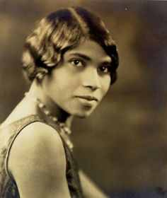
THE NATIONAL HISTORICAL Marian Anderson RESIDENCE MUSEUM & SOCIETY PRESERVING a MUSICAL Legacy with Grace & Dignity
Fall 2016 Newsletter
Brought to You By: The National MAHS
762 South Martin Street Philadelphia, Pa. 19146 (215) 779-4219

Slide 2
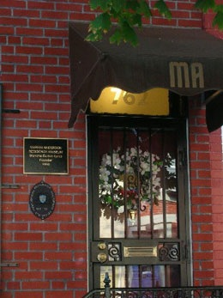
EXPERIENCING LIVING HISTORY
The National Historical Marian Anderson Museum
The Marian Anderson Historical Society is an organization that has been dedicated to promoting the late classical singer, who was considered of the most important opera performers of the 20th century, showcasing her Residence as a Museum and supporting the development and performance of Young Classical and Performing Artist Scholars. The organization was founded by Blanche Burton-Lyles and has existed for the past 15 years. The society itself consists of The Marian Anderson Residence Museum at 762 S. Martin St., where Anderson lived for much of her life. Beyond that, the area around these sites has been named the Marian Anderson Village, which proudly boasts flags around the neighborhood.

Slide 3
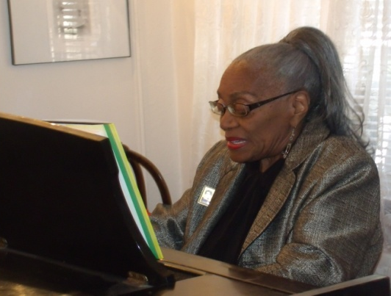
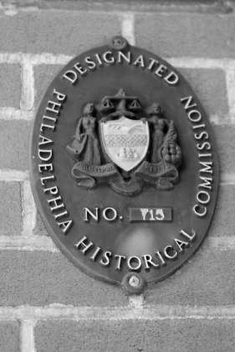
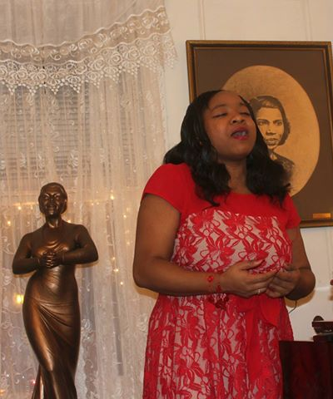
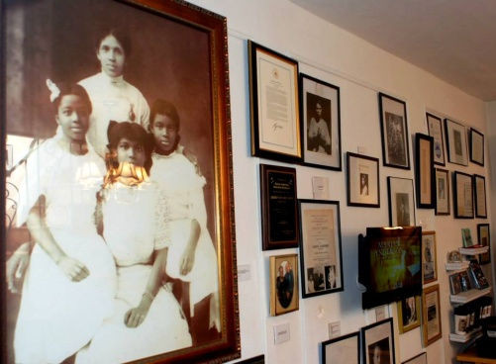
In addition to the residence house, the village contains Marian Anderson’s church, elementary school and a recreational center dedicated to her. The society is working on creating the Marian Anderson Educational Pavilion, which it says is designed to educate and produce and audio/visual interactive tour of the Marian Anderson Heritage Village.” Aside from merely promoting Anderson through displaying imagery from her life, the society seeks to spread Anderson’s music throughout the world. The scholars’ program frequently supports young classical and opera singers from around the world. These artists perform regularly at events that the society sponsors, and many have gone on to more prominent positions in places. As well as partnering with the Arts Empowerment Project to provide education, development and performance for all Children in the Arts in the Tri-State Area.

Slide 4
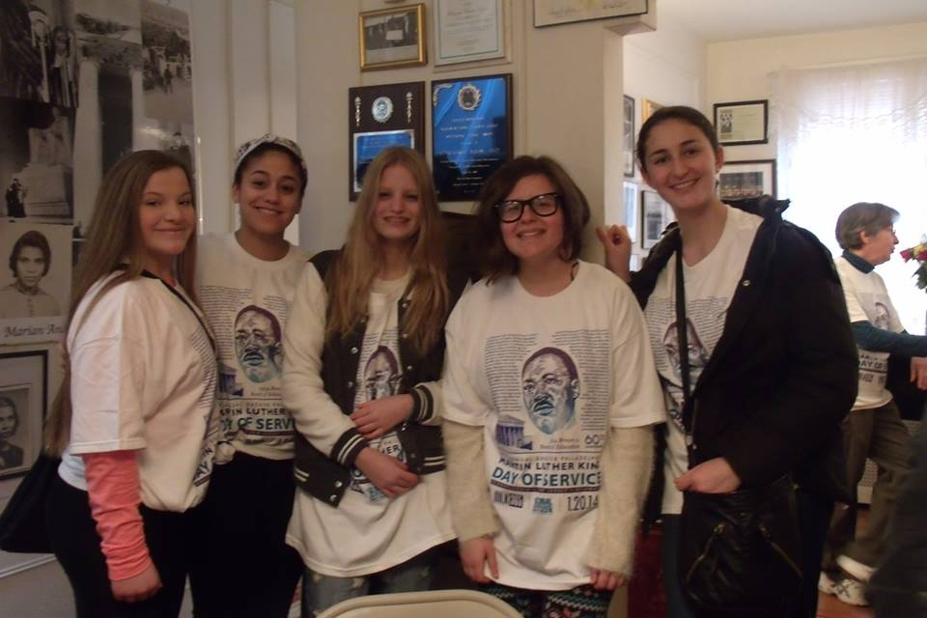
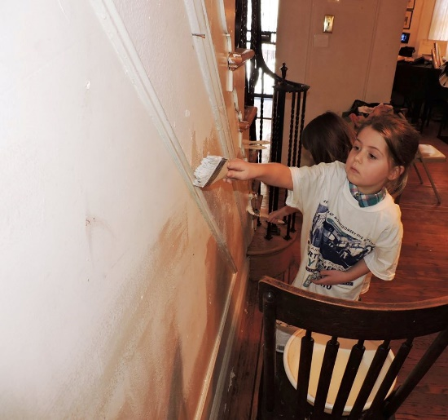
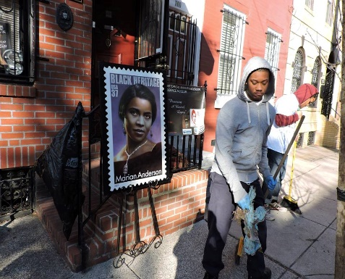
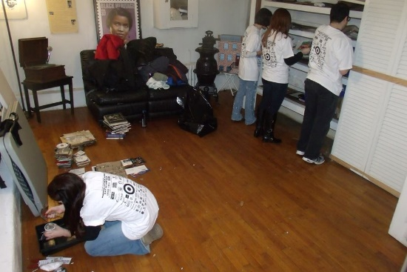
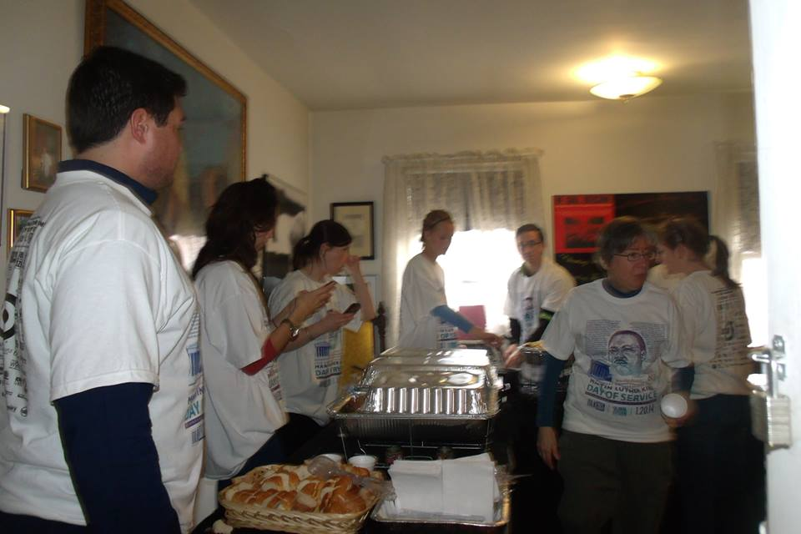
National Historical Marian Anderson Museum 2016 Year End Review
Back in January of 2016 The National Marian Anderson Museum participated for the 4th year in the National Martin Luther King Day of Service and held the museums Beautification Day in preparation for the incoming Exhibition “Marian The Music & The Gowns”. The Museum is always appreciative for the Volunteers & Support.

Slide 5
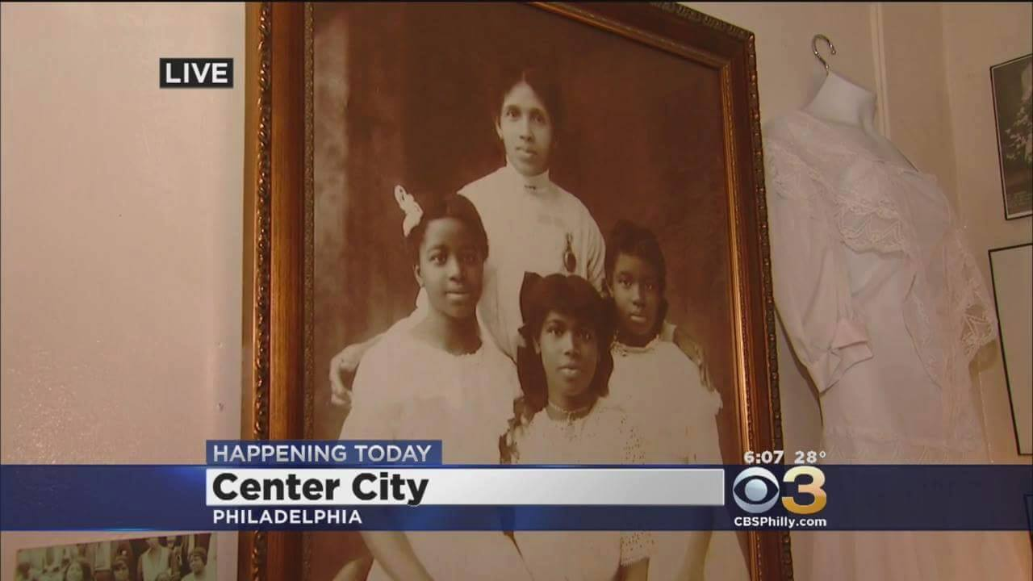
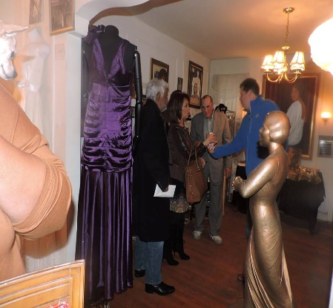
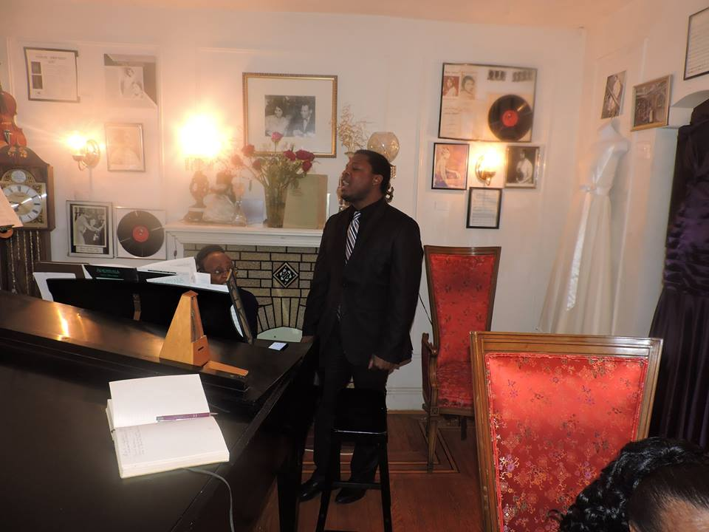
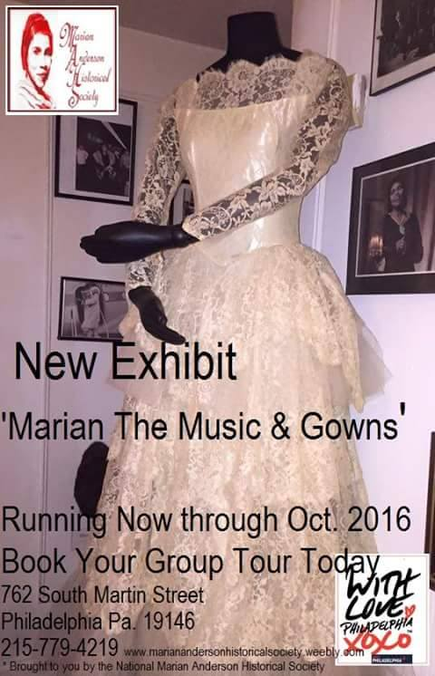
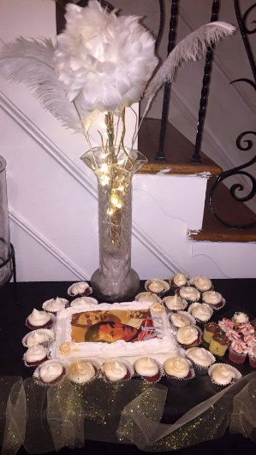
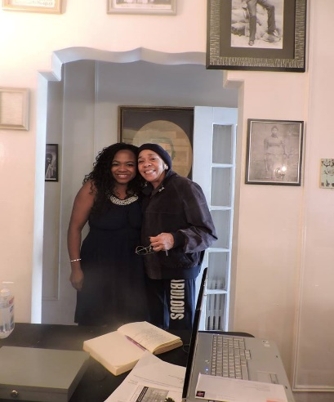
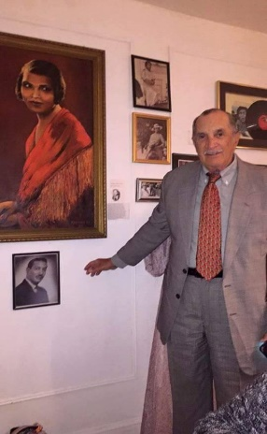
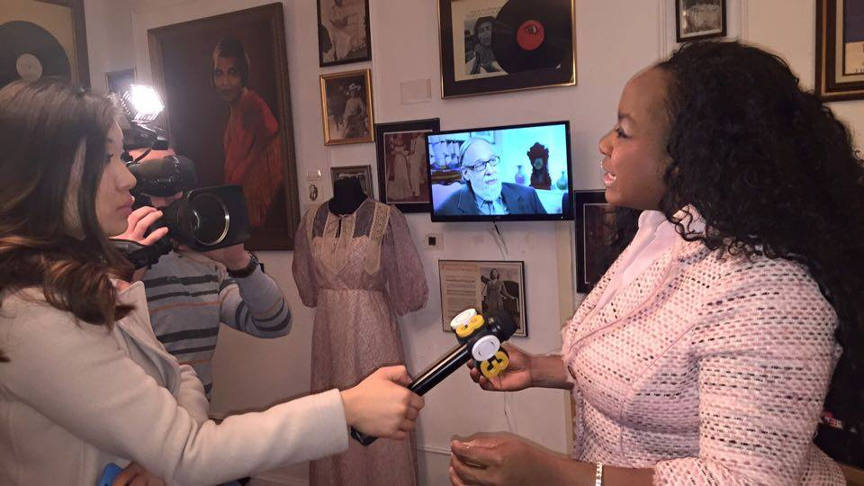
National Historical Marian Anderson Museum 2016 Year End Review
Back in February of 2016 The National Marian Anderson Museum Celebrated Marian Andersons 119th Birthday by opening our brand New Exhibit “Marian The Music & The Gowns”. February 27th was met with much excitement and fanfare at the Museum throughout the day and we were honored to Present to the Public.

Slide 6
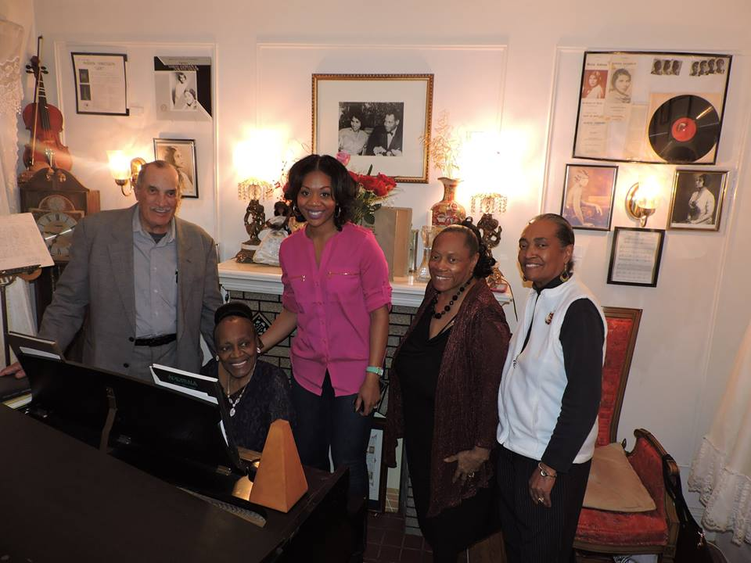
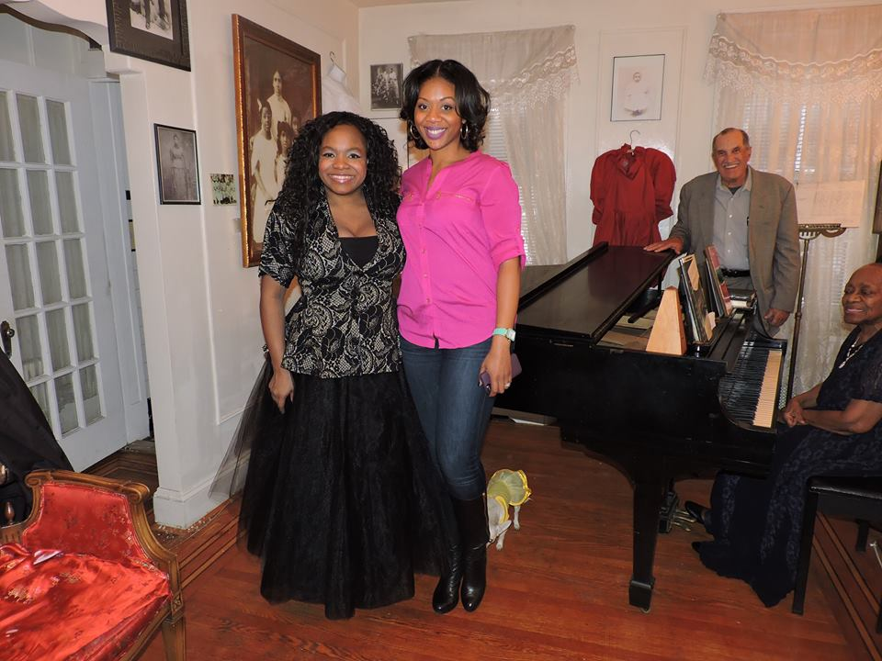
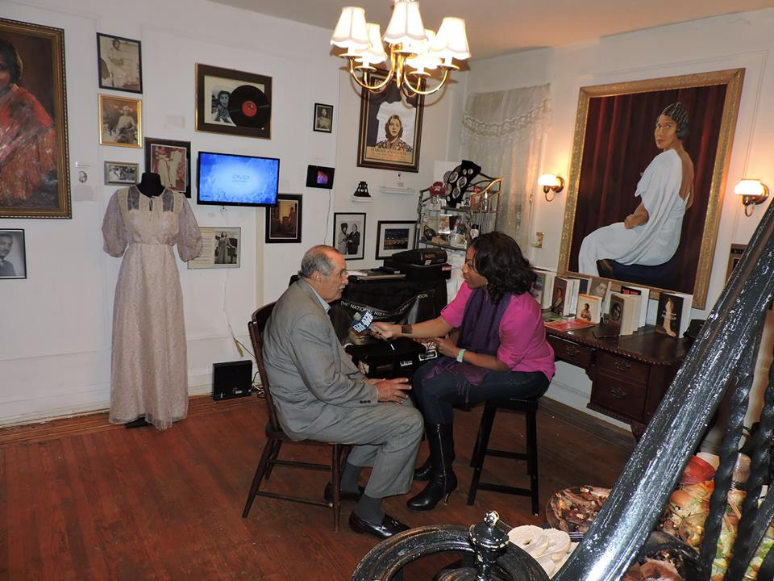
National Historical Marian Anderson Museum 2016 Year End Review
Back in March the National Marian Anderson Museum celebrated Women’s History Month with a great National Interview Feature from KYW CBS and Journalist Cherry Gregg. “Continuing Marians Legacy”

Slide 7
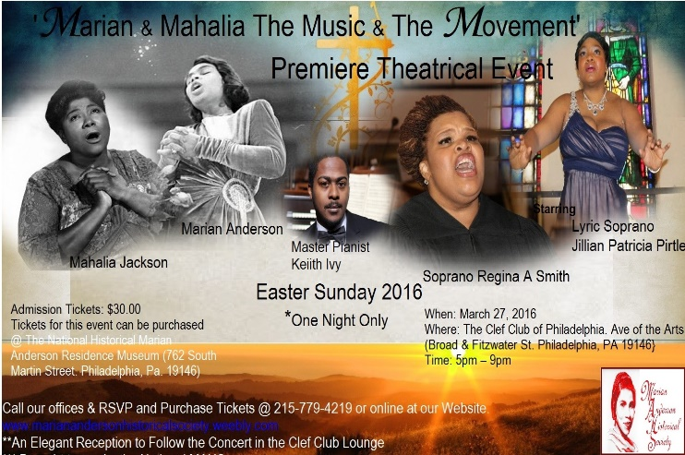
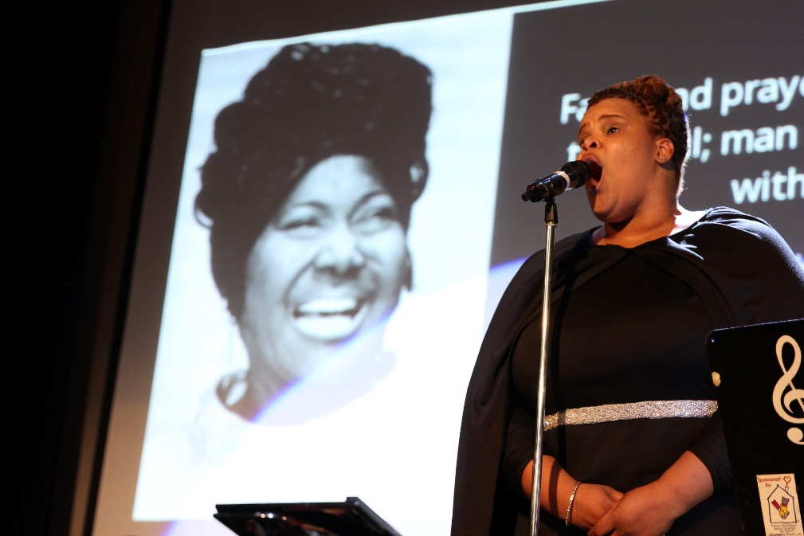
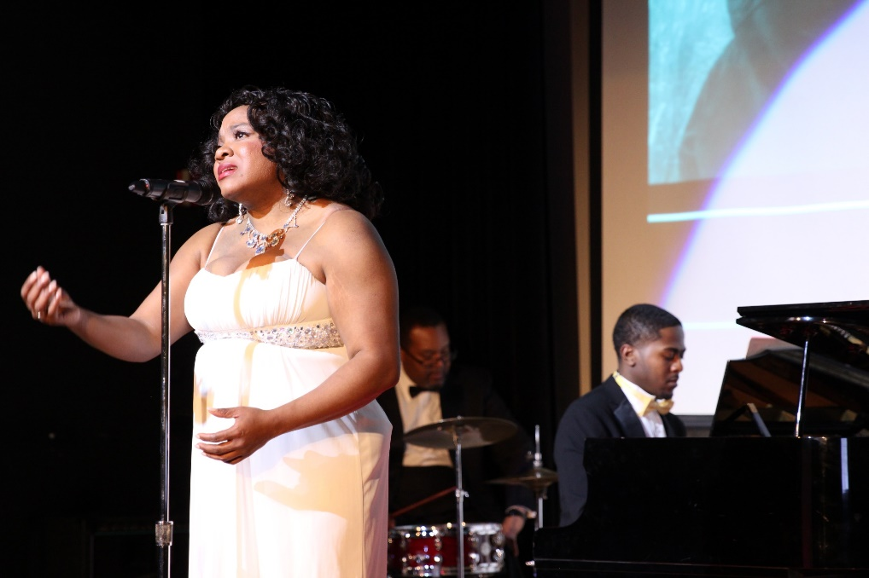
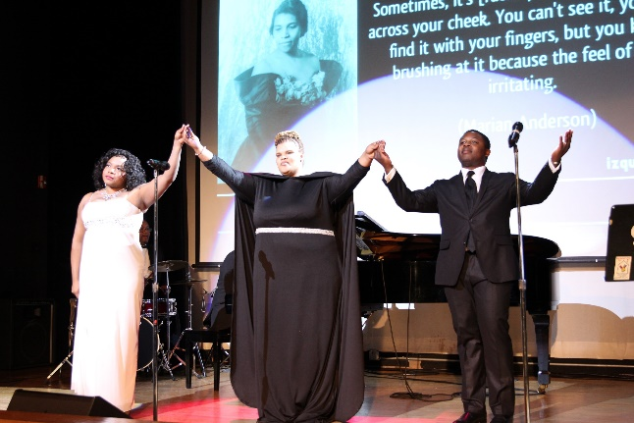
National Historical Marian Anderson Museum 2016 Year End Review
Back in April of 2016 The National Marian Anderson Museum debuted the World Premiere of the Theatrical Concert Production of ‘Marian & Mahalia The Music and the Movement” on Easter Sunday Evening at the historic Philadelphia Clef Club of Performing Arts.

Slide 8
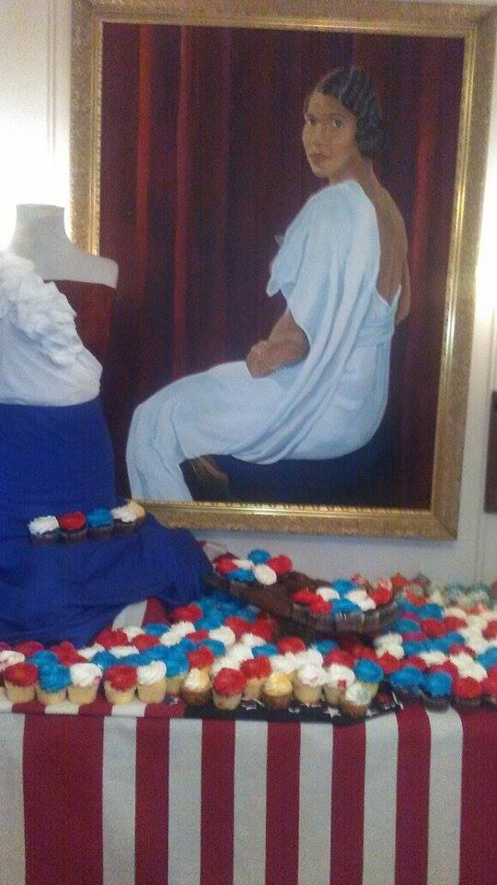
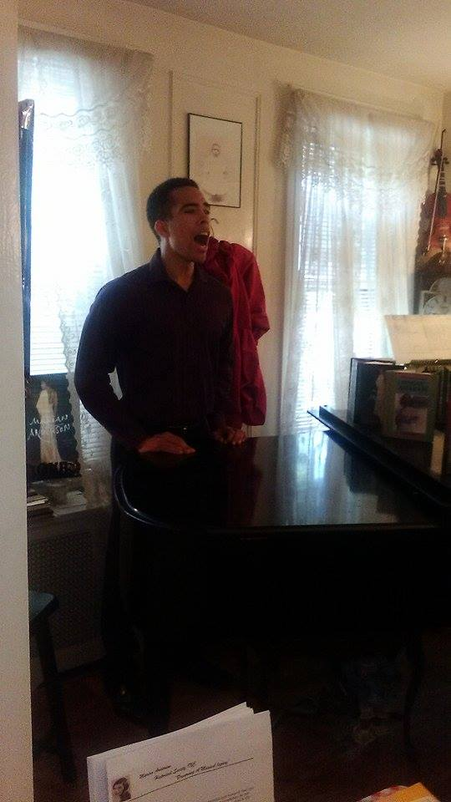
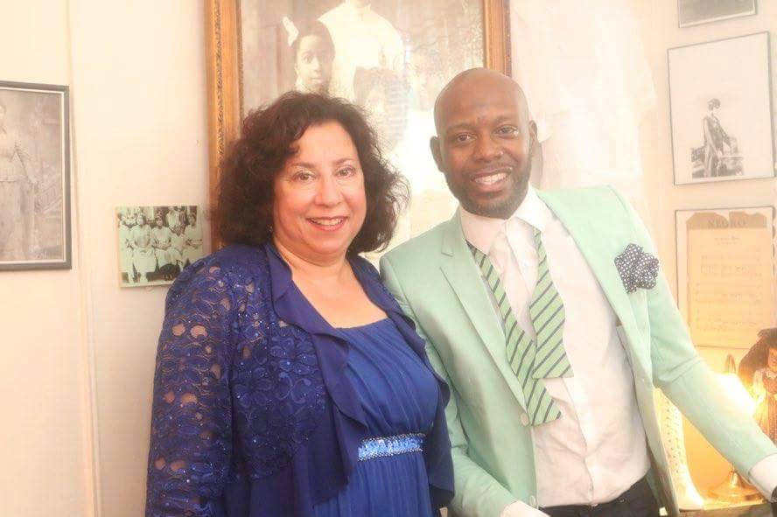
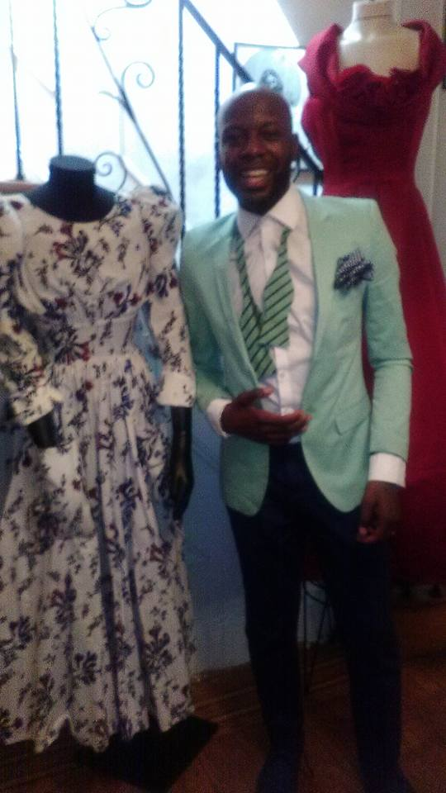
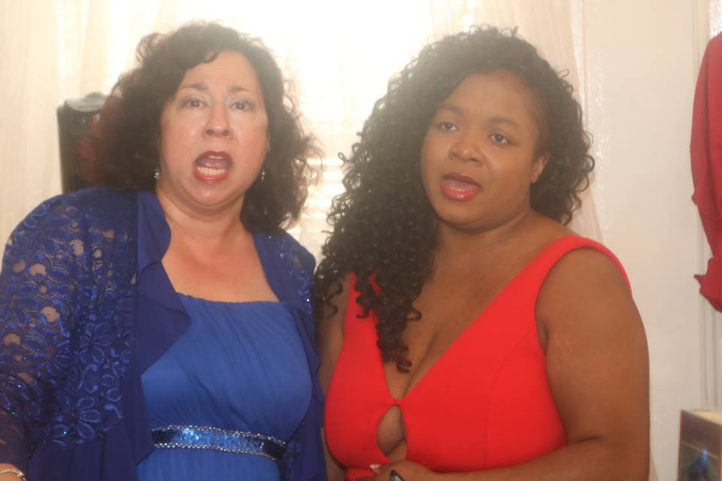
National Historical Marian Anderson Museum 2016 Year End Review
Back In July The National Marian Anderson Museum ‘Welcomed America’ with our ‘Marian & Here Patriotic Americana Open House day” . The event was filled with American Nostalgia and Patriotic Musical Celebration.

Slide 9
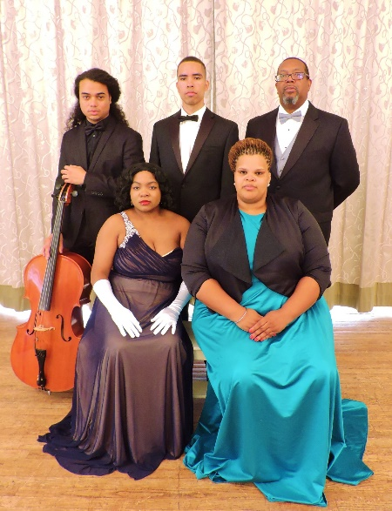
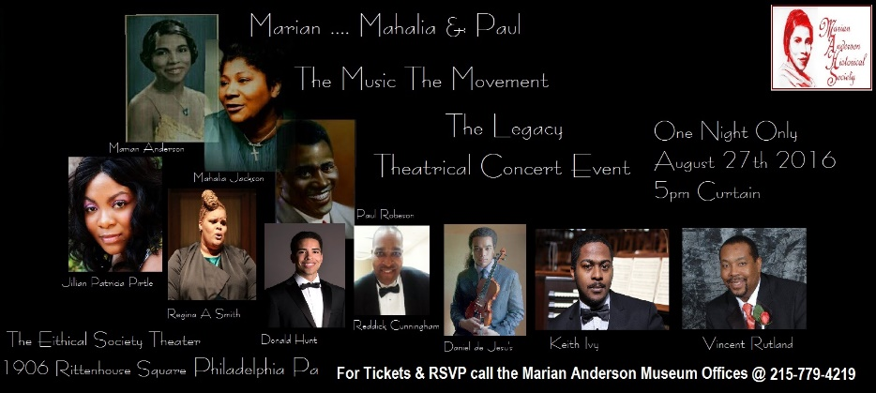
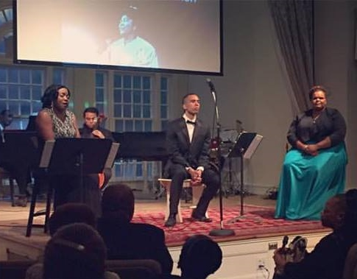
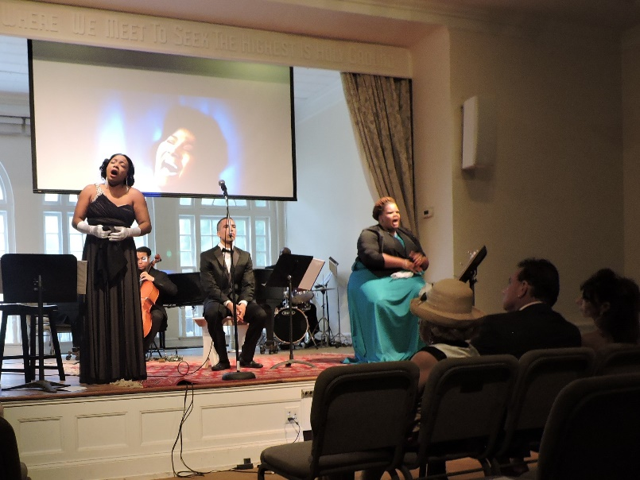
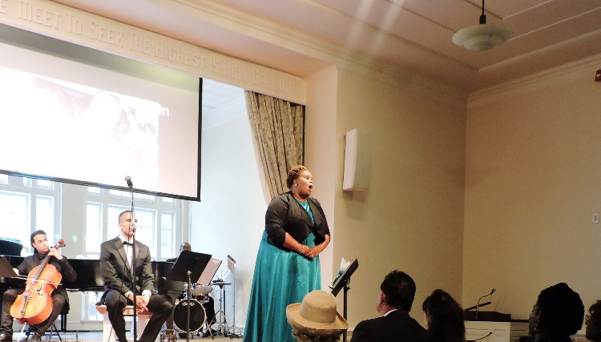
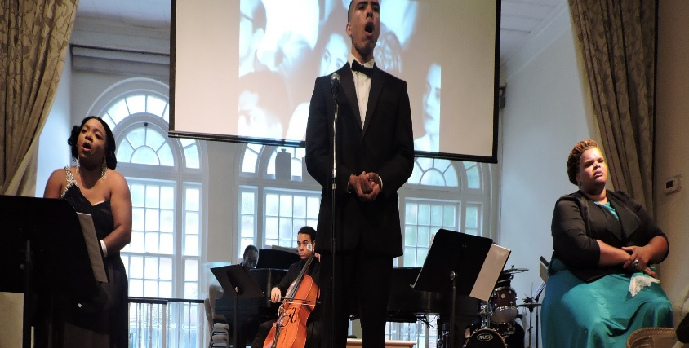
National Historical Marian Anderson Museum 2016 Year End Review
Back in August 2016 the National Marian Anderson Museum had an Outstanding 2nd showing of the Premiere Theatrical Production ‘Marian Mahlaia & Paul The Music Movement & Legacy’ at the Historic Ethical Society Theatre’.

Slide 10
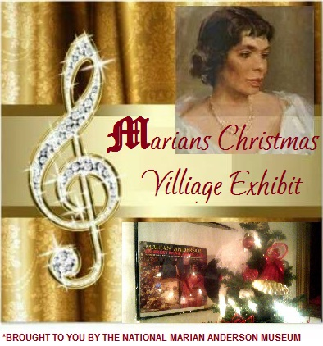
National Historical Marian Anderson Museum 2016 Year End Review
Coming ahead for the National Marian Anderson Museum
November 2016 Opening ‘Marian’s Christmas Village Exhibit’

Slide 11
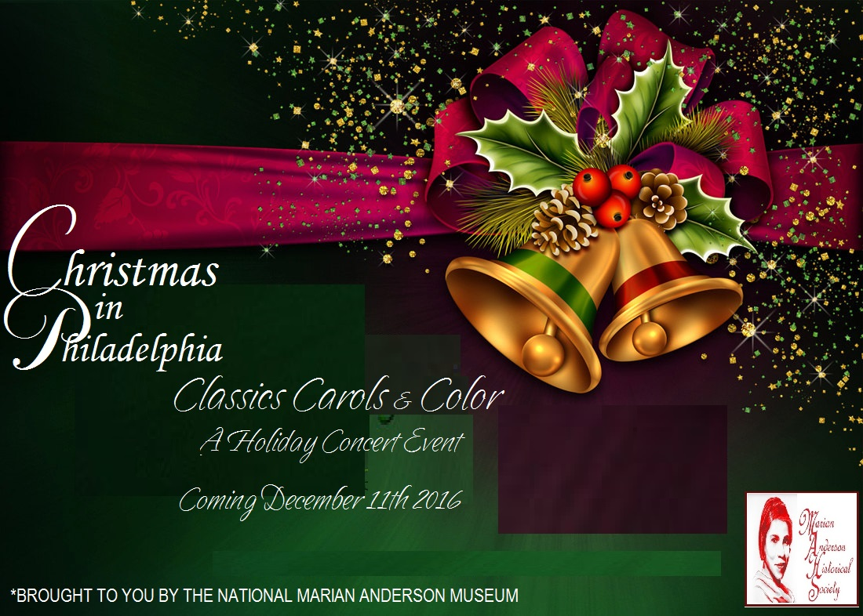
National Historical Marian Anderson Museum 2016 Year End Review
Coming ahead for the National Marian Anderson Museum
December 2016 National MAHS Presents: ‘Christmas In Philadelphia Classics Carols and Color’ Concert Event

Slide 12
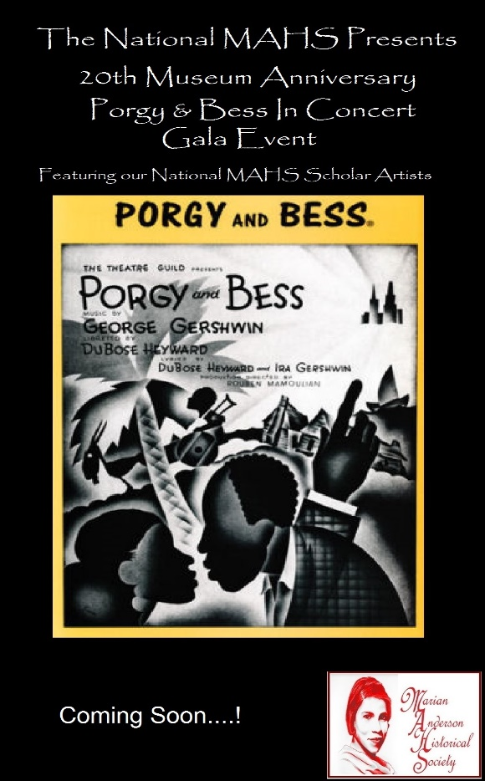
Coming ahead for the National Marian Anderson Museum
National Marian Anderson Museum 2017 Season
(With over 12 Special Events coming in 2017 this will be the National Marian Anderson Museums Greatest Season Yet)

